Slide 1
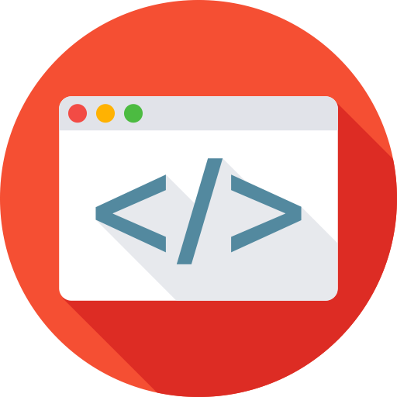


Exploring JS (4)
By Elham Jaffar

Slide 2
Build Tools

Slide 3
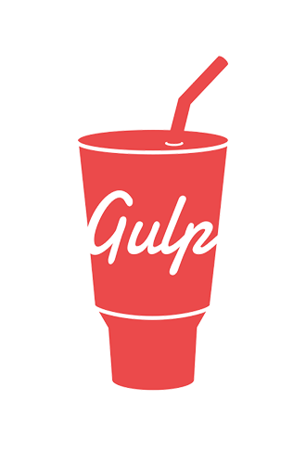
Gulp
What is Gulp?
Gulp is a tool that solves the problem of repetition.

Slide 4
Why Gulp
Automated repetitive tasks
more time to do non repetitive tasks
more productivity :)

Slide 5
What Gulp can do?
Bundling and minifying libraries and stylesheets.
Copying modified files to an output directory.
Quickly running unit tests.
Running code analysis.
and more ..

Slide 6
To start
install -g gulp
npm init
npm install --save-dev gulp
create a gulpfile.js
Start

Slide 7
Most used plugins:
Name | Description
gulp-uglify | JavaScript compressor.
gulp-standard | Check JavaScript code style with standers.
gulp-jshint | To detect syntax errors in JavaScript files.
gulp-htmlhint | HTML validator.
gulp-htmlmin | minify html files.
gulp-uncss | remove unused CSS from your projects.
gulp-csso | CSS minificator
gulp-concat | concatenate files.
gulp-imagemin | Minify image size.

Slide 8
Sass
Sass is an extension of CSS that adds power and elegance to the basic language. It allows you to use variables, nested rules, mixins, inline imports, and more, all with a fully CSS-compatible syntax. Sass helps keep large stylesheets well-organized, and get small stylesheets up and running quickly, particularly with the help of the Compass style library.

Slide 9

Grunt vs gulp
vs
It is like code vs configuration.
Grunt is based on configuring separate independent tasks, each task opens/handles/closes file.
Gulp requires less amount of code and is based on Node streams, which allows it to build pipe chains (w/o reopening the same file) and makes it faster.

Slide 10
Linting
A linting tool helps us avoid mistakes when writing JavaScript. Despite of our programming levels, we still type variable names incorrectly, make syntax errors and forget to handle our errors properly. Linters will help us !

Slide 11
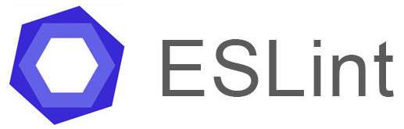
Linting
There are number of Linters: (Here is my recommendation)
It can be installed with gulp ☺
Flexible: any rule can be toggled, and many rules have extra settings that can be tweaked
Very extensible and has many plugins available
Easy to understand output
Includes many rules not available in other linters, making ESLint more useful for detecting problems
Best ES6 support, and also the only tool to support JSX
Supports custom reporters

Slide 12
Unit testing
UNIT TESTING verifies that a relatively small piece of code is doing what it is intended to do. They are narrow in scope and do not check outside systems.

Slide 13
Integration Tests
Integration Tests demonstrate that different pieces of the system work together.

Slide 14
Regression Tests
Regression Tests product-oriented tests that make sure that new changes do not break mission-critical functionality that has already been built (logging in/out, checkout out).

Slide 15
A Common test Practice
You may be familiar with the following steps:
Write code
Manually test outcomes This can be useful when you're trying to learn the basics, move quickly, and prototype.

Slide 16
Consider that ….
Projects can live a long time
Code bases can get big
Developers come and go
Time required for manually testing adds up
"upgrades" and "bug fixes" can break other features

Slide 17
How to start ?
Set expectations
Think through the steps
Break down the pieces

Slide 18
Benefit of testing
Shorten feedback loop
prevent regressions
Document code

Slide 19
What to test ?
inputs/outputs – when something goes into a function, what should come out?
"side effects" – when a function executes, what will change outside of the function?

Slide 20
What is tdd?
Test-driven Development (TDD) is an approach to programming.
Write an automated (failing) test. This test will describe the desired behavior
Write a small amount of code that will make the test pass
Repeat

Slide 21
What is tdd?
Test-driven Development (TDD) is an approach to programming.
Write an automated (failing) test. This test will describe the desired behavior
Write a small amount of code that will make the test pass
Repeat

Slide 22
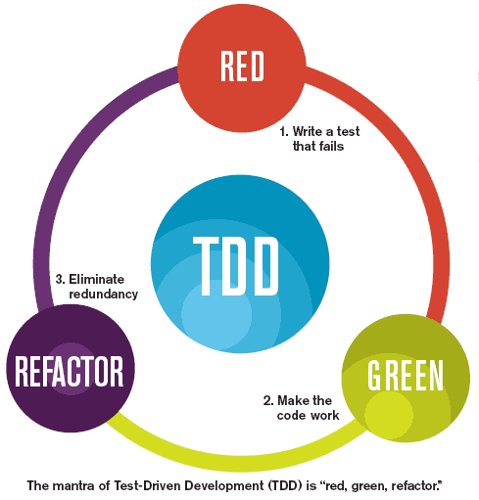
Red Green Refactor cycle
This cycle is typically executed once for every complete unit test, or once every dozen or so cycles of the three laws. The rules of this cycle are simple.
Create a unit tests that fails
Write production code that makes that test pass.
Clean up the mess you just made.

Slide 23
What is BDD?
Behavior-driven Development (BDD) emerged out of TDD as an approach to programming that considers both business and technical needs.
From the developer perspective, BDD is a style of TDD that uses English in a natural way to describe expected behavior.

Slide 24

Jasmine
It is a behavior-driven development framework for testing JavaScript code. It does not depend on any other JavaScript frameworks. It does not require a DOM. And it has a clean, obvious syntax so that you can easily write tests.

Slide 25
Jasmine & gulp
+

Slide 26
terminology
Spec
A spec is short for "specification". This is a building block in Jasmine that describes a certain behavior precisely
Suite
A suite is a grouping of specs

Slide 27
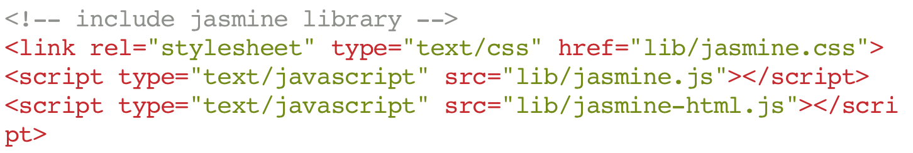
Setting up version (2.2)
In the coming project, you'll be running tests in a browser from a file called SpecRunner.html. That means, you need to make sure your files are loaded before we write tests. Here's how:

Slide 28
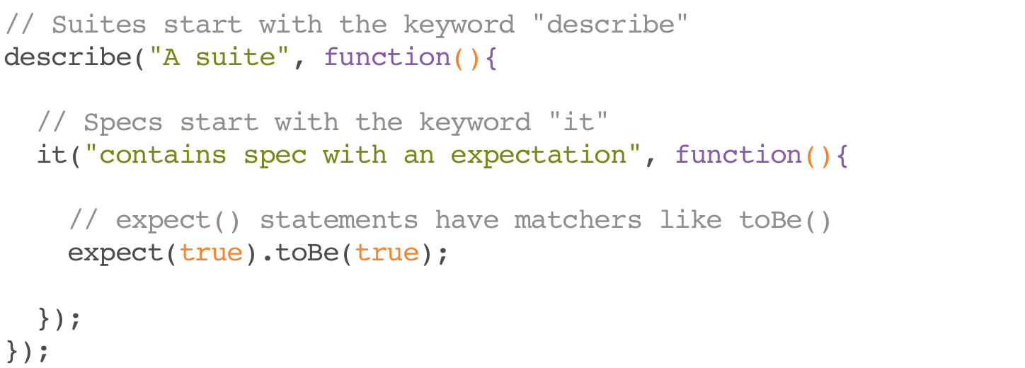
Suites, specs, and matchers

Slide 29
toBe() or not.toBe() and other matchers
There are special functions called matchers that will compare an actual value with an expected value.
toBe() //compares with ===
not.toBe() //compares with !==
toBeDefined() //compares against `undefined`
toEqual() //strict equality, works for simple literals and variables
toMatch() //for regular expressions ‘string’
toContain() //find an item in an array
Click Here !

Slide 30
Jasmine Exercise
Click Here !
Notes:
https://www.w3resource.com/javascript-exercises/javascript-function-exercise-6.php

Slide 31
Feed Reader Testing Project

Slide 32

Remember that we are here to help you
All you have to do is ASK!
Thank you for Attending

